Slide 1



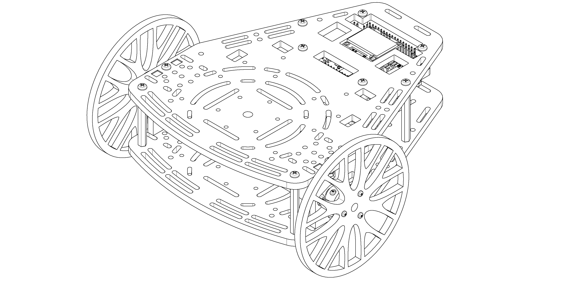
Computer Vision in ROS
OpenCV Interface
Traffic Light detection

Slide 2
The Task
Detect and respond to a traffic light

Slide 3
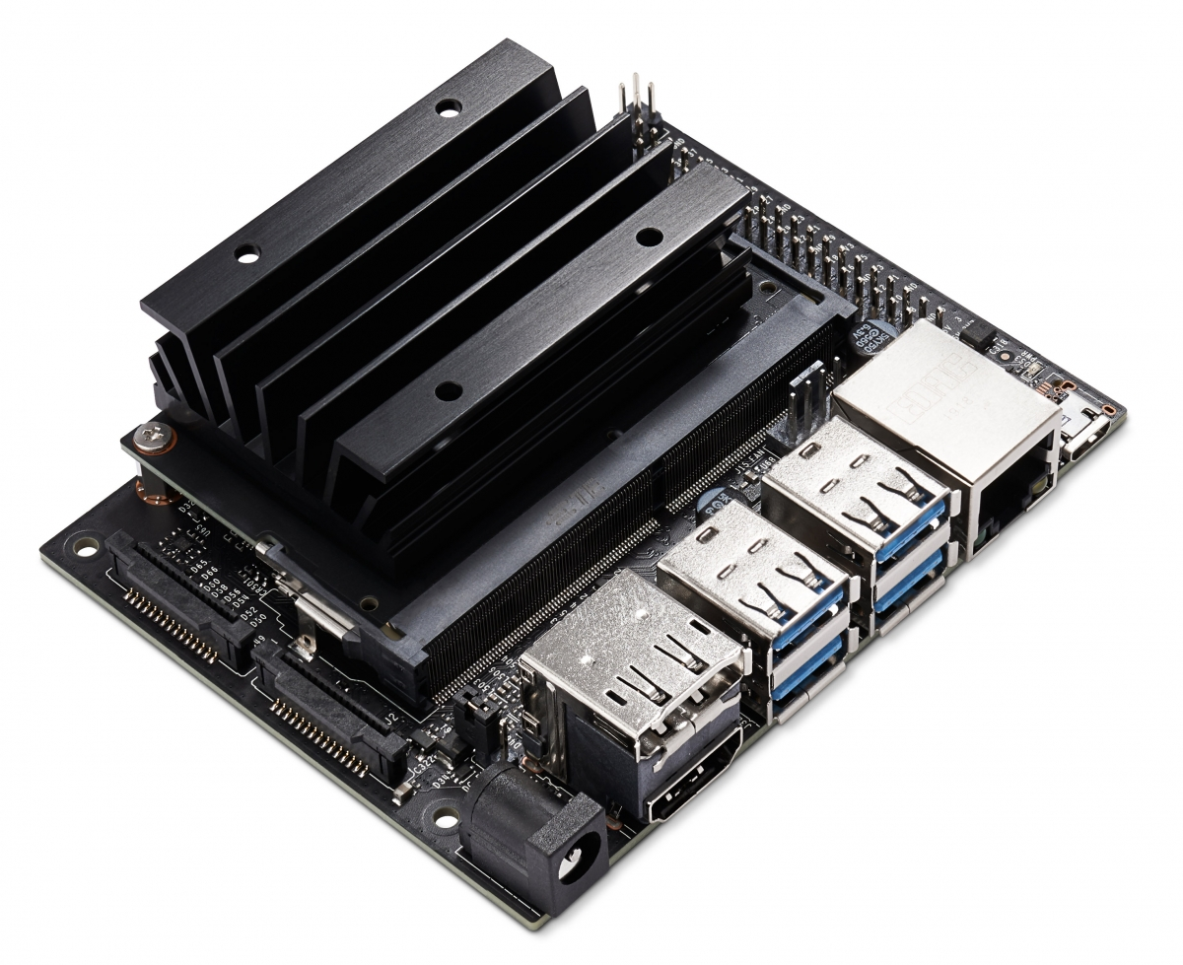
The Jetson Nano 2GB
128-core NVIDA Maxwell GPU
1.43 GHz Quad-core ARM A57 CPU
2 GB of 64-bit LPDDR4 Memory
SD card for storage
Ethernet & WiFi
CSI-2 Connector for Camera
Runs a modified version of Ubuntu 18.04

Slide 4
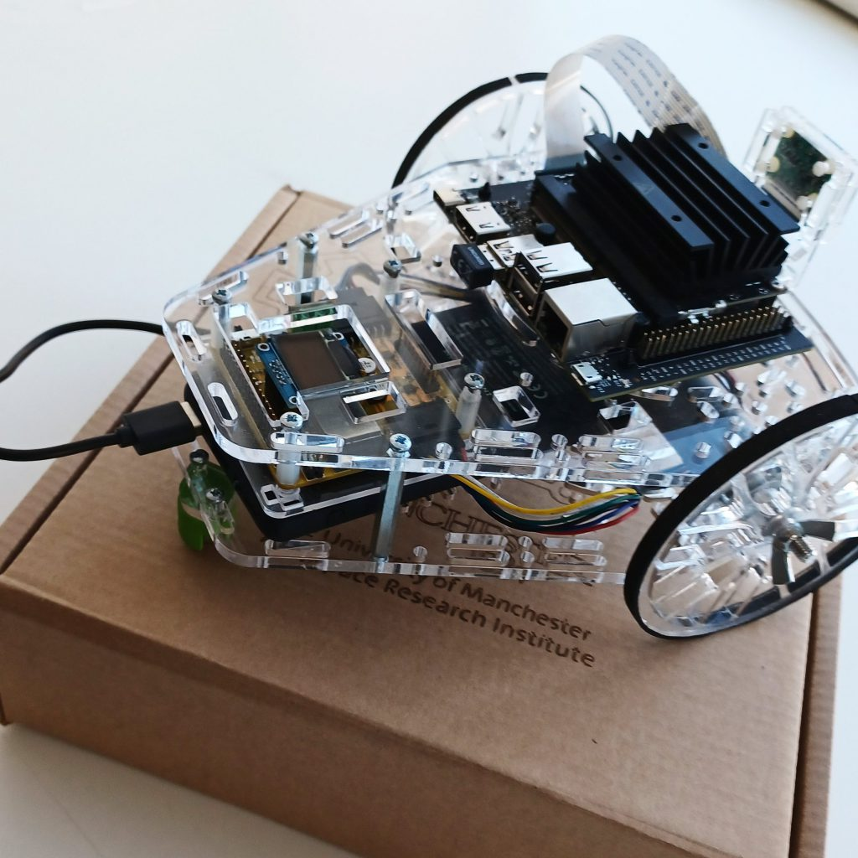
The Jetson vs The Hacker Board
Higher processing power
Time-sharing operating system
Good for more complex, slower tasks
Specially designed by nvidia for AI
Low processing power
Real-time operating system
Good for simple, fast, time-sensitive tasks

Slide 5

OpenCV
Open Source Computer Vision Library
Cross-platform, free to use
Originally developed by Intel
Aimed at real-time computer vision
Contains a wealth of functions and routines for the real-time processing and analysis of images

Slide 6
Interfacing with ROS
OpenCV comes preinstalled on the Jetson
ROS uses a package called CV Bridge to interface with OpenCV:
sudo apt install ros-melodic-cv-bridge
To enable OpenCV in the ROS environment on the Jetson, add the following to the CMakeLists.txt in the package where OpenCV is required:
set(OpenCV_DIR /usr/share/OpenCV)
find_package(catkin REQUIRED COMPONENTS(OpenCV)
Once this line is added, OpenCV methods can be imported into python using:
import cv2

Slide 7
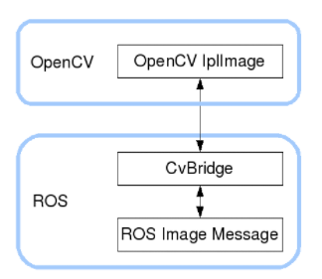
Accessing Images in ROS
The ROS package cv_bridge provides tools to enable OpenCV to manipulate images transmitted using ROS
sudo apt install ros-melodic-cv-bridge
bridge = cv_bridge.CvBridge()
image = bridge.imgmsg_to_cv2(msg,encoding=‘passthrough’)
img_back = bridge.cv2_to_imgmsg(result_image)
http://wiki.ros.org/cv_bridge/Tutorials/ConvertingBetweenROSImagesAndOpenCVImagesPython

Slide 8
Image Processing Node
rospy.Subscriber
cv_bridge.imgmsg_to_cv2
ROS Image Subscriber
Convert to OpenCV Image
Pre-processing
Image Analysis
Input Image
ROS Image Publisher
Convert to ROS message
Draw data on image
Data Processing
ROS Publisher
Output Image
cv_bridge.cv2_to_imgmsg
Output Data
rospy.Publisher
rospy.Publisher

Slide 9
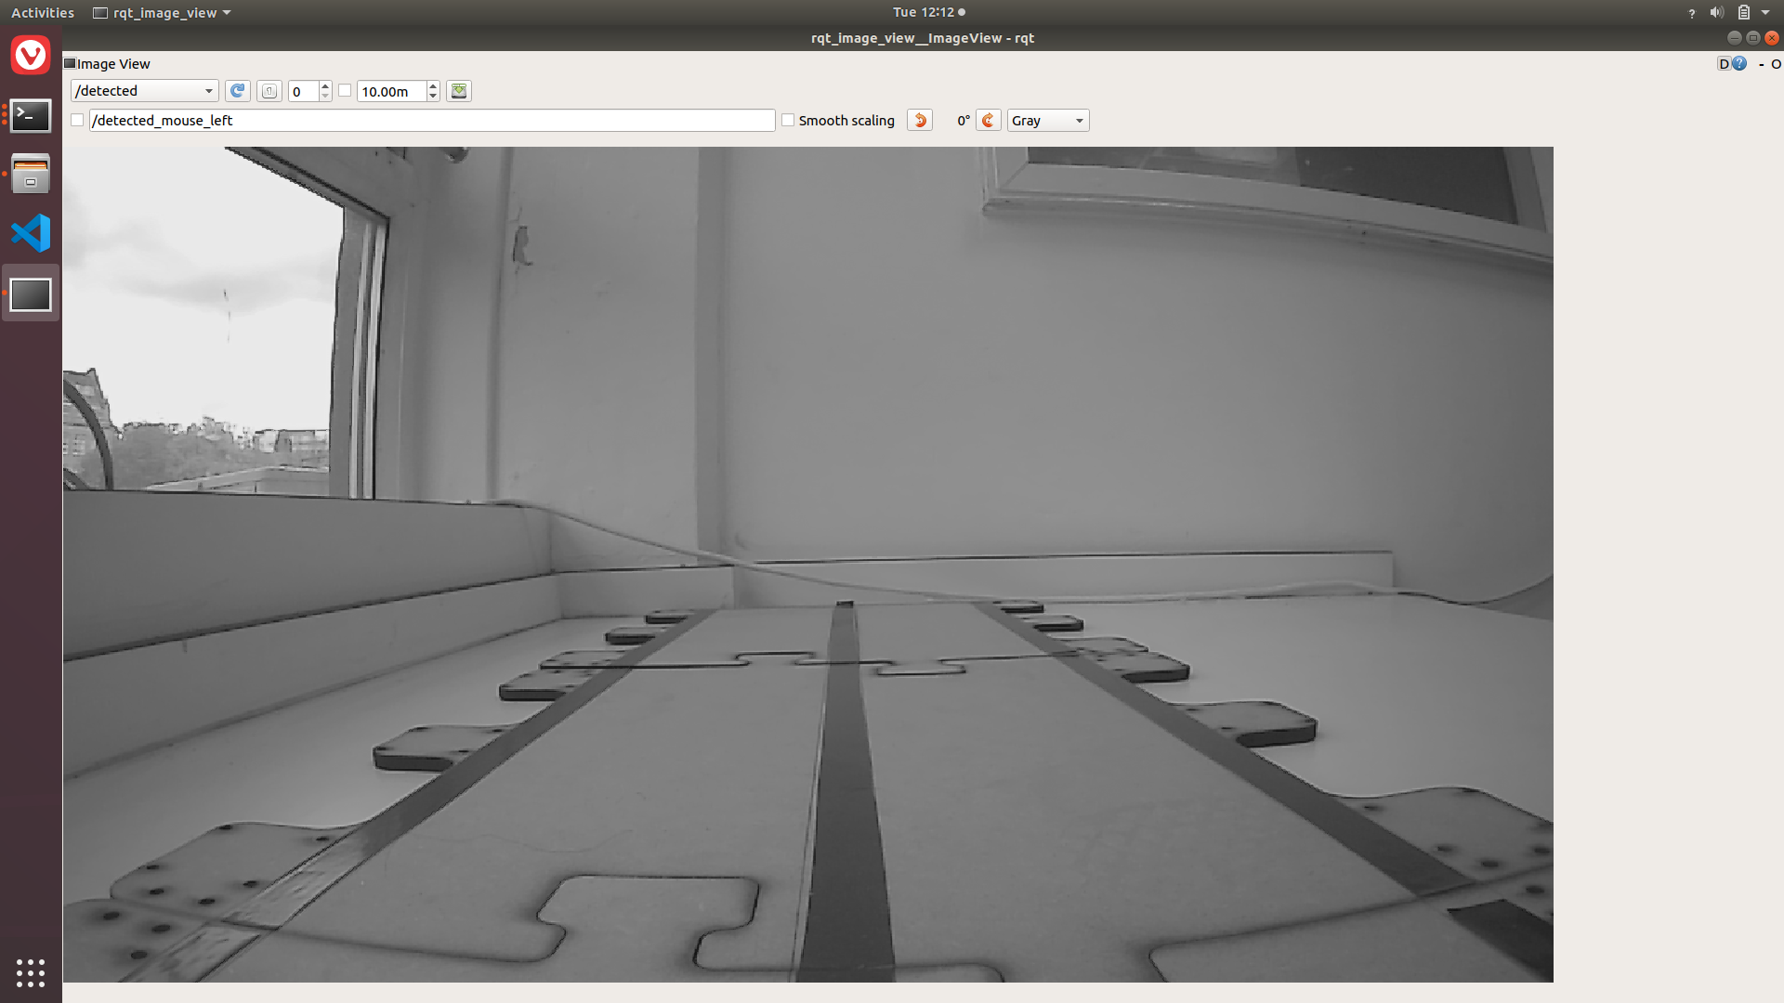
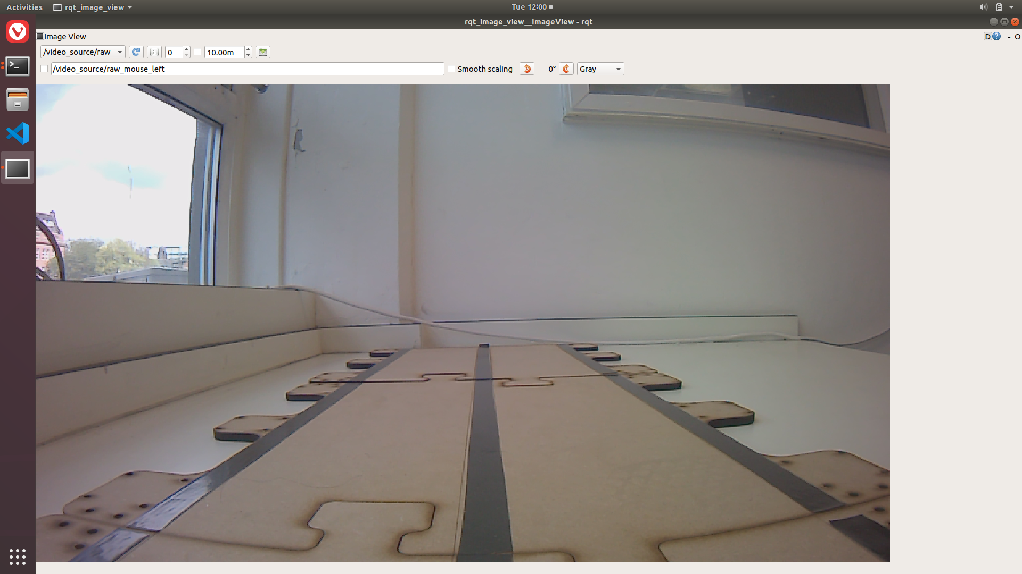

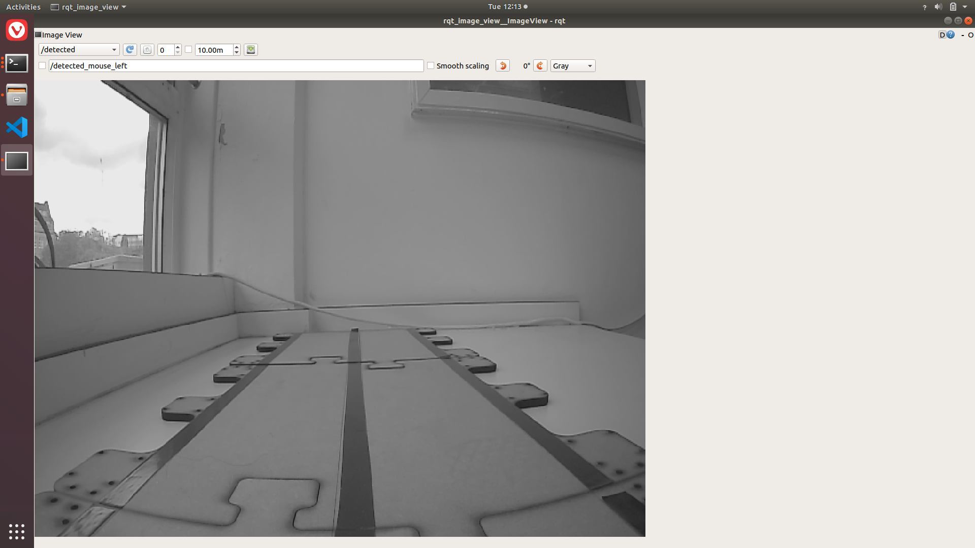
Pre-processing
Rotate image if necessary
Change image encoding if desired
Reduce image size
Apply initial noise reduction

Slide 10
Activity: Image processing framework
Create a node that implements the basic framework described previously
It should subscribe to the camera images, perform all the pre-processing, and then publish the processed image.
Test different parameters in the pre-processing and observe the impact on the output topic
Image size
Gaussian Blur size

Slide 11
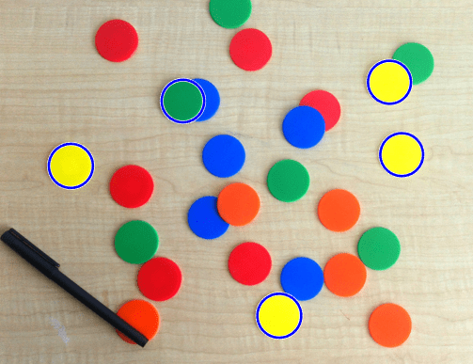
OpenCV What is the problem?
We aim to detect connected regions in the space with a characteristic shape and colour palette.
Characteristics to exploit
We can look for patches of certain colors
We can use size to reject shapes
We can look for circular shapes in the image
Example of the problem

Slide 12
OpenCV Proposed solution outline
ROS Image Subscriber
Convert to OpenCV Image
Pre-processing
Image Analysis
Input Image
ROS Image Publisher
Convert to ROS message
Draw data on image
Data Processing
ROS Publisher
Output Image
Output Data
Apply color filtering
Remove noisy regions of the space
Detect potential candidates
Apply logic to decide if we trust the detection

Slide 13
Colour Filtering
Convert the base image to the hsv space
Filter the image to remove all colours not defined as red or green, storing the results in two separate images
Use OpenCV’s inRange function
Suggested values for the colours required
https://docs.opencv.org/4.x/de/d25/imgproc_color_conversions.html
https://docs.opencv.org/3.4/da/d97/tutorial_threshold_inRange.html
 | RED | GREEN
H | 0-33 | 49-98
S | 88-255 | 39-255
V | 179-255 | 130-255

Slide 14
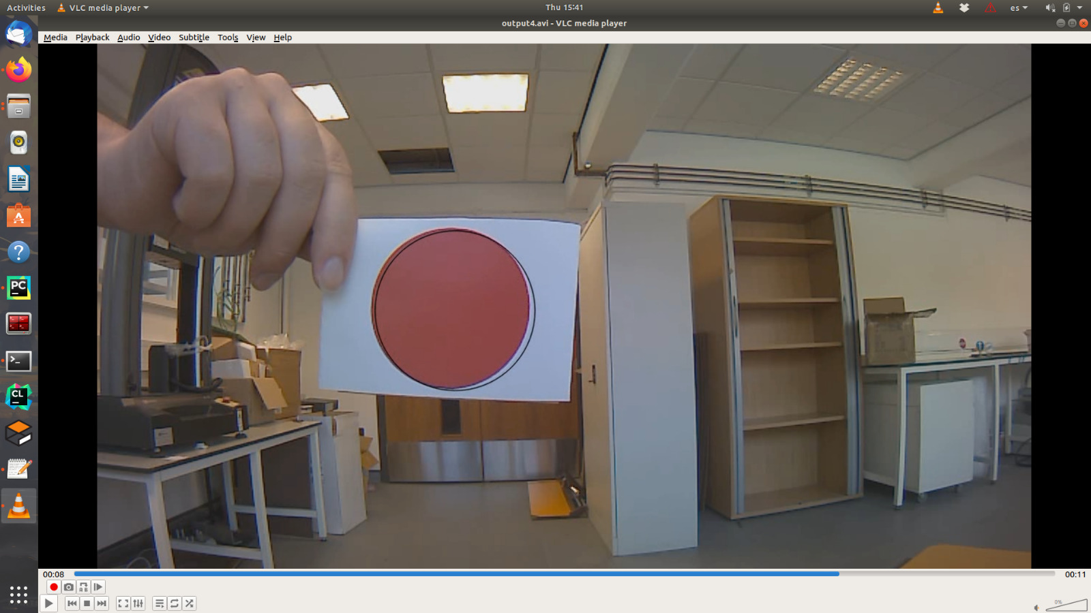
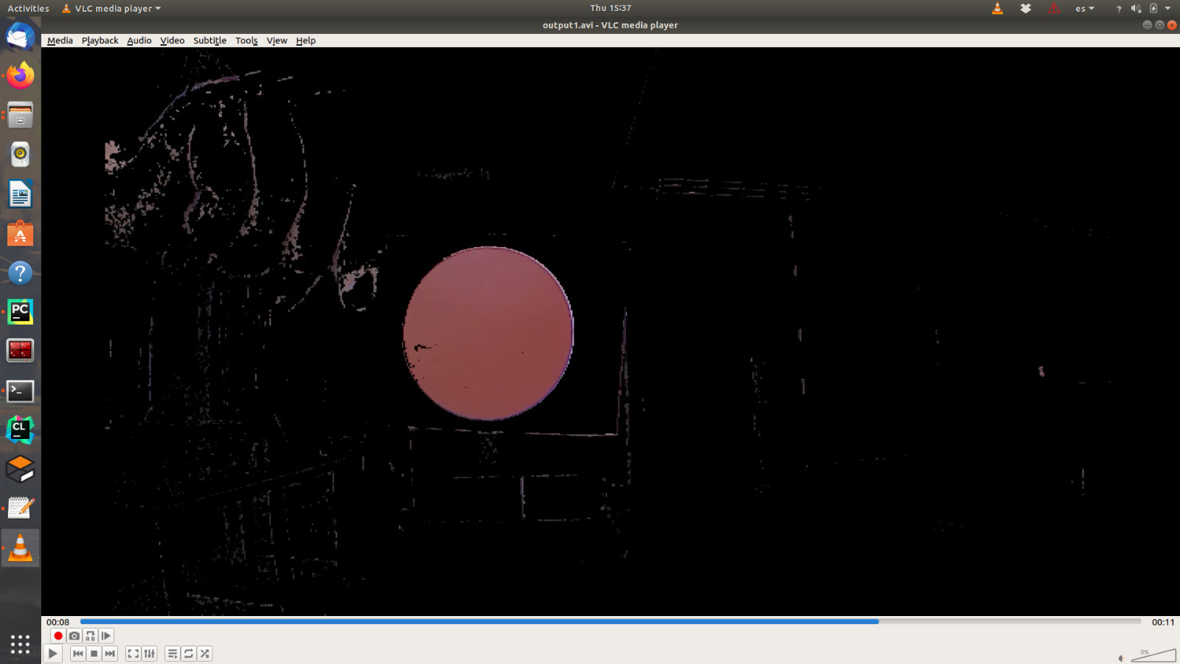
Colour Filtering Before
Colour Filtering After

Slide 15
Thresholding
Now to remove the background
This is done with a simple binary threshold
use OpenCV’s threshold function
https://docs.opencv.org/4.x/d7/d4d/tutorial_py_thresholding.html

Slide 16
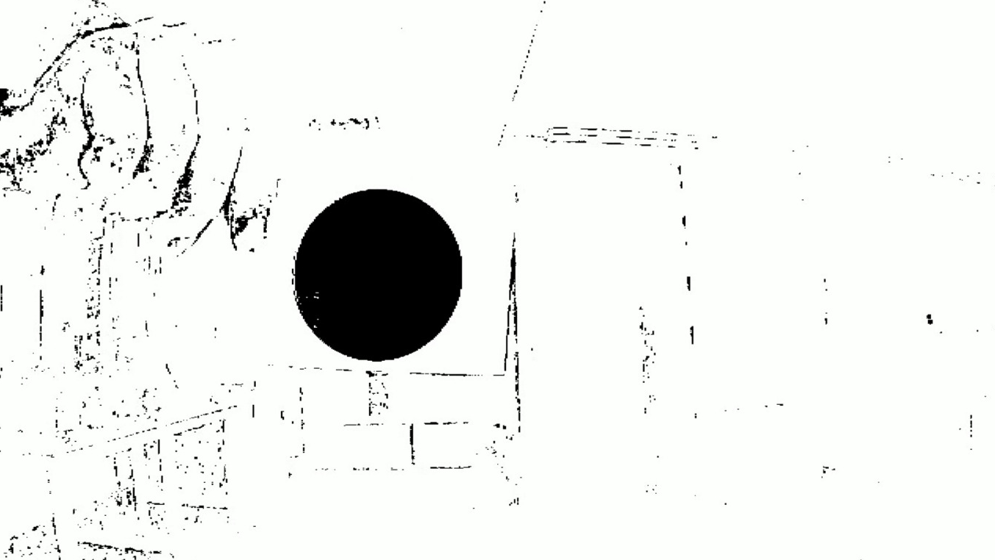
Thresholding Before
Thresholding After

Slide 17
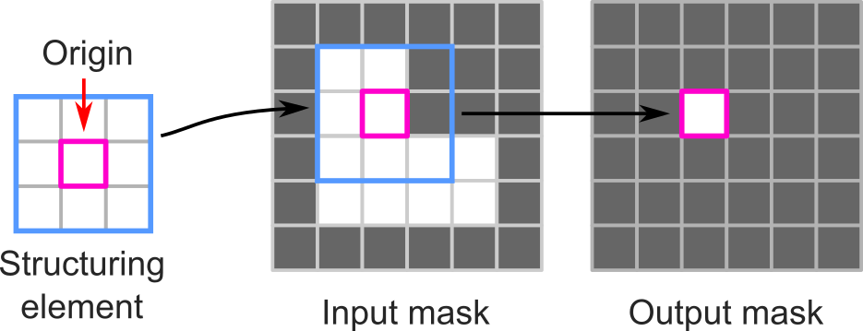

OpenCV Noise rejection in color filtering
It is common that artifacts appear in the images after applying certain operations.
Noisy image
One of the most common techniques to deal with this artifacts is known as a morphological operators. Morphological operators are defined as a combination between an image and a structuring element.
After some initial operations to an original image, we can see some noise in the result that we want to remove

Slide 18



OpenCV Noise removal tools
Erode
Dilate
Using a mask (kernel) we compute the minimal value of a given area around a pixel and we replace it by that value. The results of this technique are shrinking the larger regions and removing the smallest ones.
We convolute each pixel of an image with a given kernel, resulting in shapes becoming larger and smoothing their edges

Slide 19
OpenCV Using morphological operators in OpenCV
In order to apply any morphological operator, we will need to define 3 things.
The mask: it will define the area of effect of our operation, for example in an erosion the bigger the mask the smaller will the final shape be.
The operation: OpenCV has functions defining the most common operators, so it is a matter of selecting the suitable option
The number of iterations: It is common to apply this operations recursively, so OpenCV allows setting the number of iterations that are going to be made.
You can find more details about how this technique is used in the documentation link below.
Documentation: https://docs.opencv.org/3.4/db/df6/tutorial_erosion_dilatation.html

Slide 20
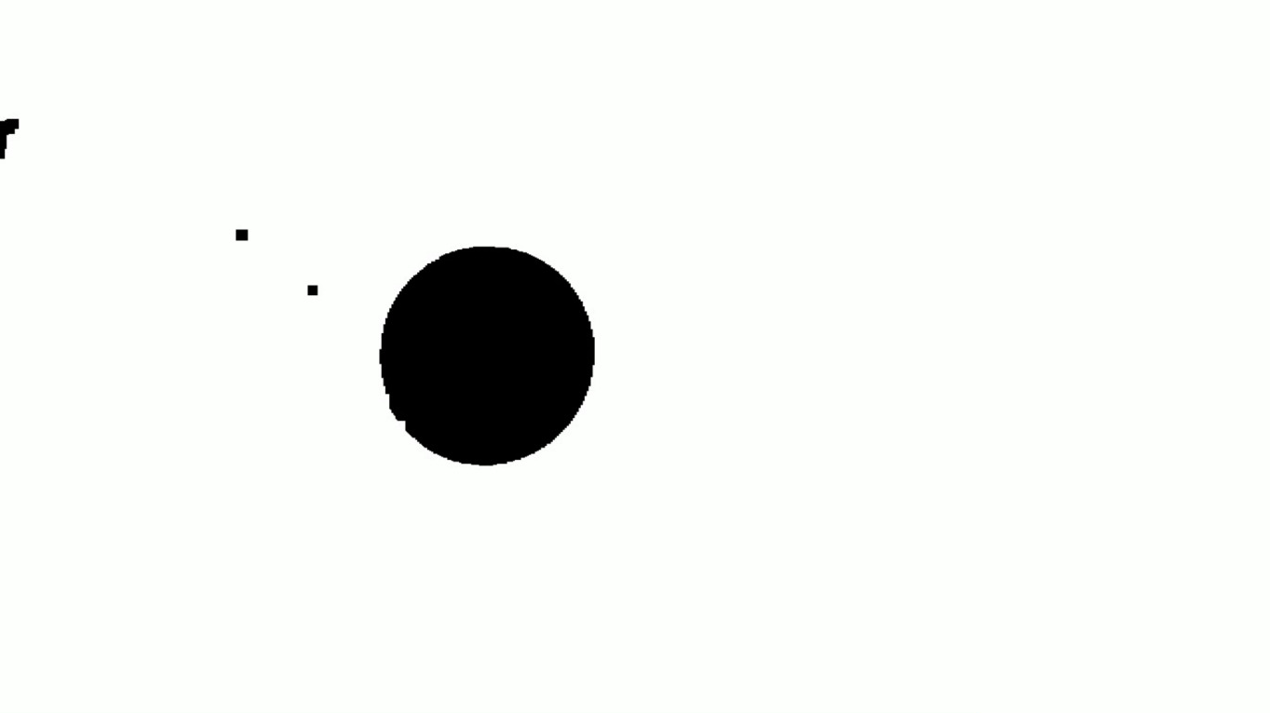
Noise Removal Before
Noise Removal After

Slide 21
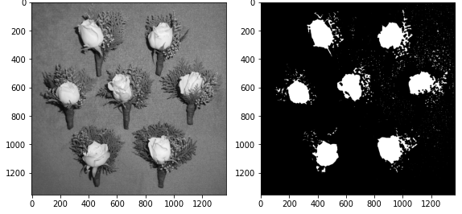
OpenCV What is a blob?
A Blob is a group of connected pixels in an image that share some common property. In the image above, the dark connected regions are blobs, and the goal of blob detection is to identify and mark these regions.
Grayscale image
Resulting blobs after processing

Slide 22
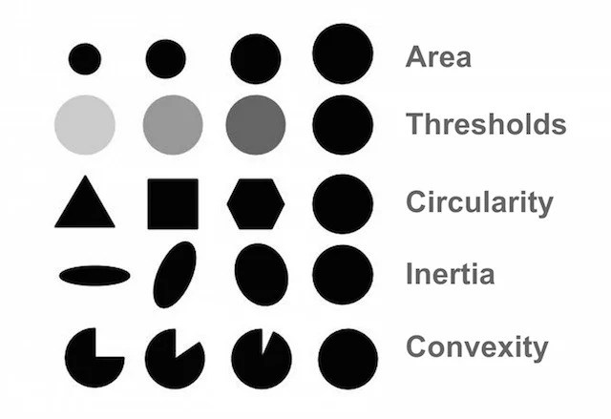
OpenCV How to detect a blob?
OpenCV allows to apply the following filters when detecting blobs. The function ”simple_blob_detector” will take them into account while looking for groups of pixels in contact with each other.
It is the job of the user to decide properly the parameters so that the detection matches your previous knowledge of the blob to detect, for instance if the region is big enough or close enough to a circle.
Documentation:
https://learnopencv.com/blob-detection-using-opencv-python-c/

Slide 23
OpenCV Blob detection in OpenCV
Blob detection is already implement in an OpenCV method, which will analyse a binary image and return the blobs and their characteristics. In order to use it two objects need to be created
SimpleBlobDetector_Param: Is used to configure the criteria that defines a blob, you’ll have to activate each filter (a list was presented in the previous slide) and then set a maximum and minimum value for it. We recommend to focus on using Area and Circularity for this course.
SimpleBlobDetector_create: It creates the object used to detect the blobs
The output of this function is an vector containing information of each of the regions detected in the image
Documentation: https://docs.opencv.org/4.x/d0/d7a/classcv_1_1SimpleBlobDetector.html

Slide 24
Activity Colored blob detection
Create a ROS node that uses either a live video stream (for example a web cam) or some images. Set up your experiments with colored circles of different sizes and detect them. You will have to detect green and red circles and publish that information into a ROS topic.
Practical considerations
OpenCV Requires a specific format to work properly, use the package ”cv_bridge” to reformat them properly
Use color filtering to remove noise and shapes that you don’t want to consider as part of the solution
Try your code with different lighting conditions and make it robust to small variations

